Slide 1
Digital humanities programming - Now with 50% more Python!
HILT 2019

Slide 2
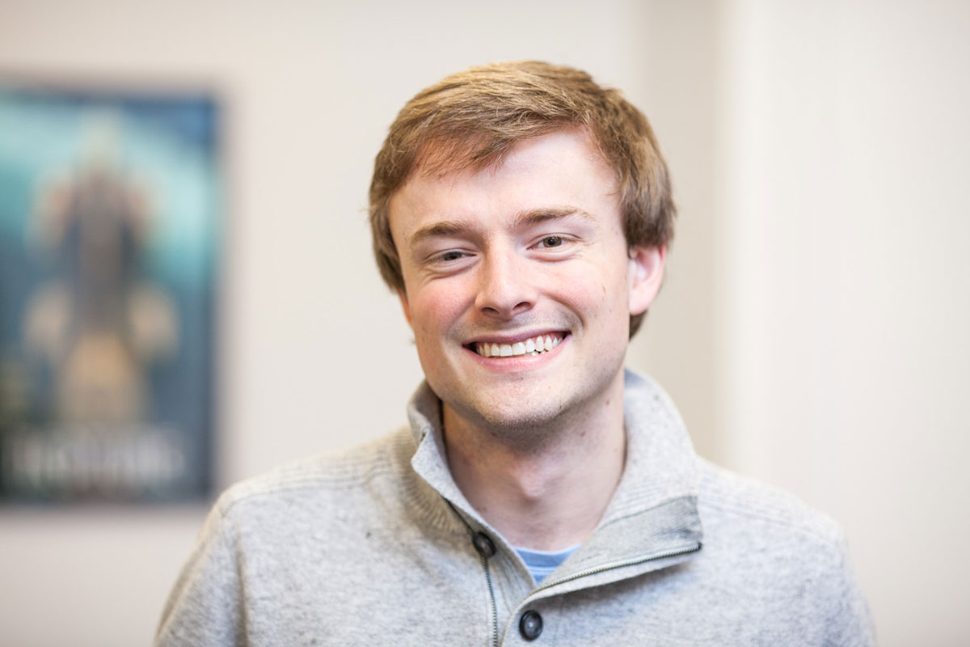
GitHub: walshbr
@walshbr

Slide 3

GitHub: reedeth
@reedeth

Slide 4
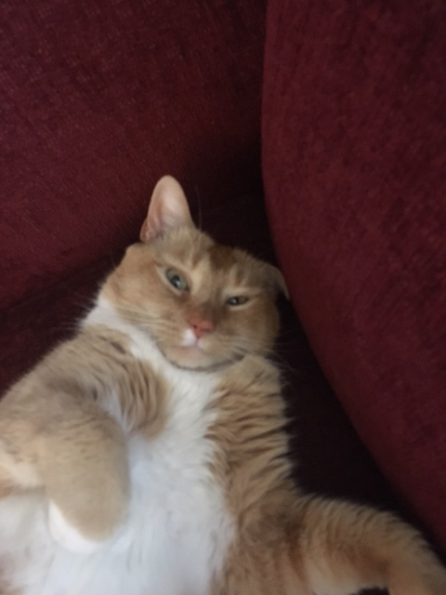
GitHub: @tony
@thecat

Slide 5
Week’s Trajectory
Introduce the command line
Introduce source code management
Introduce programming concepts w/ Python
Apply Python to real-life DH situations

Slide 6
Pedagogical Approach
A mix!
Some programming together
Some talking over slides
Some independent work
Collaboration is encouraged!
Notes:
To be frank the course title is a pedagogical intervention – trying to get a particular audience in the room.
Hope is that the course will give you a way in, help you get started and help you apply these things to your real life.

Slide 7
What to expect
Lots of hands-on activities
Lots of new concepts
Humorous pictures
Your brain will hurt at some point

Slide 8
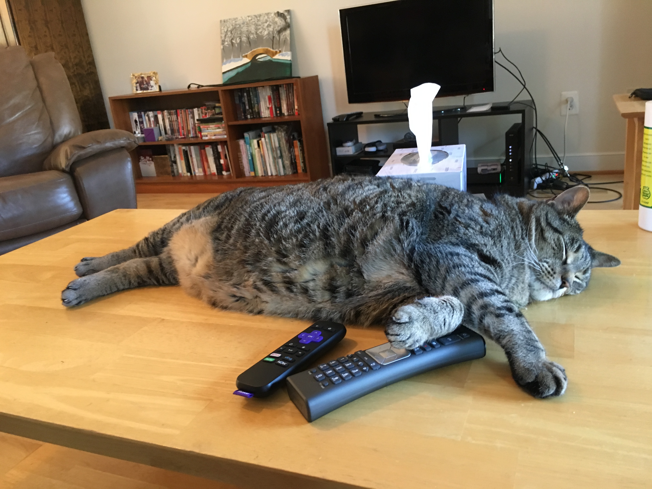
Notes:
Technology is hard!
We are going to have trouble at some point with the technology this week
who hasn't gotten their personal laptop set up yet

Slide 9
Ground Rules
Asking questions is a “super power”
If you need a mental (or other break), take one
Writing software is a collaborative endeavor

Slide 10
Post-it Notes
All have three colors: Green, Red, White
Green: things are good
Red: need help
White: Done
Green and (especially) white offer help to red
Credit to Miriam Posner and Deb Verhoeven

Slide 11
slack
hilt-institute.slack.com
Another avenue for asking for help and sharing
/giphy word

Slide 12
Code of conduct
We are dedicated to creating a safe, respectful, and collegial learning environment for the benefit of everyone who attends.

Slide 13
Other Important Stuff
Coffee
Lunch
Supper

Slide 14
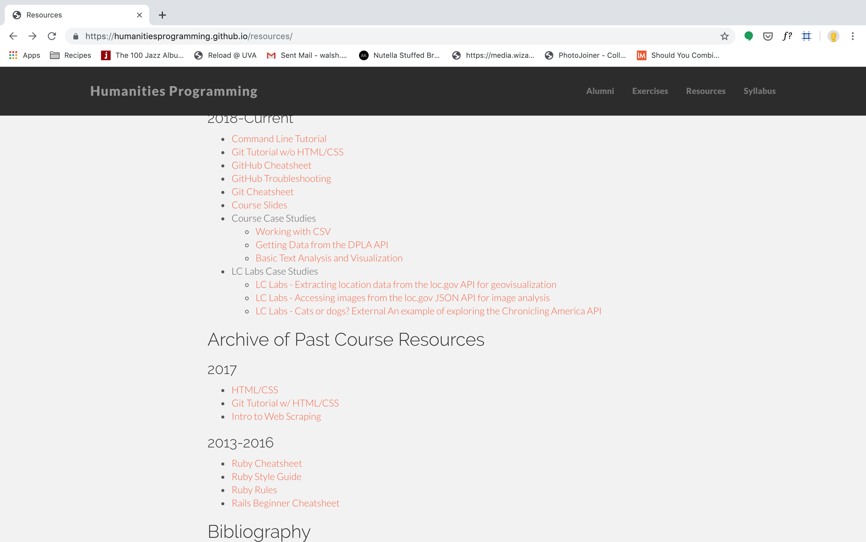
Slides
https://humanitiesprogramming.github.io/resources/

Slide 15
Note on Powerpoint
Autocorrect is a nightmare for code
Be very wary of copying and pasting from the slide decks if you're following along.
And also the odd human error might pop in.
Everything will be fine – that's why we have post-its!

Slide 16
Introductions
What is your name?
What institution are you from?
What is your background with programming/tech/DH?
What is one thing you want to learn this week?

